Slide 1
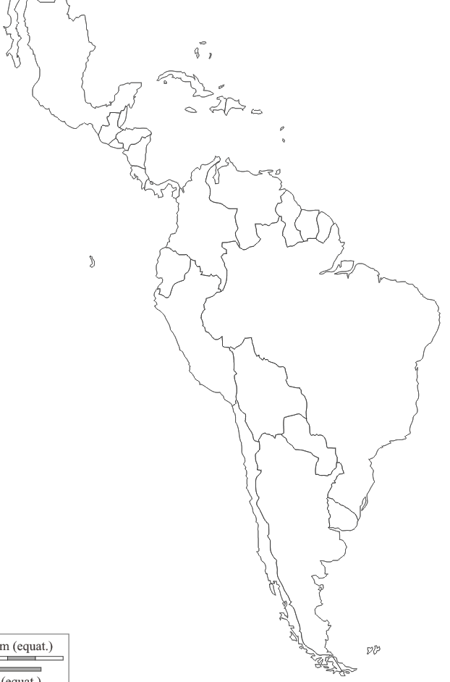

Slide 2
Mi pais hispanohablante es _____________________________.
Las comidas:
__________________________ _____________________
__________________________ _____________________
__________________________ _____________________
El tiempo (weather, in Spanish):
__________________________ _____________________
Los sitios (landmarks):
__________________________ _____________________
__________________________ _____________________
Las exportaciones (exports):
__________________________ _____________________
__________________________ _____________________
Flag:

